Slide 1
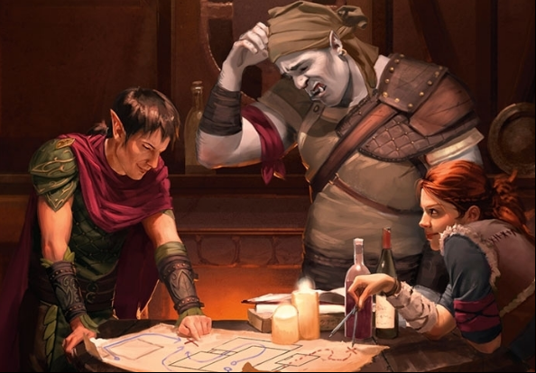
Dungeon Master Resource
For the speedy D&D player

Slide 2

Imagine this…
You and your buddies are playing Dungeons and dragons, and you are the dungeon master.
The other players reach the dark forest, but you haven’t created any treasure, monsters, or NPCs there
You don’t want to pause the game for 15+ minutes to frantically search for the right thing to generate (right)
You before

Slide 3

The idea…
Our idea is to create a website that allows a dungeon master to quickly generate treasures, monsters, and NPCs
All you need to do is enter the correct specifications.
You after

Slide 4
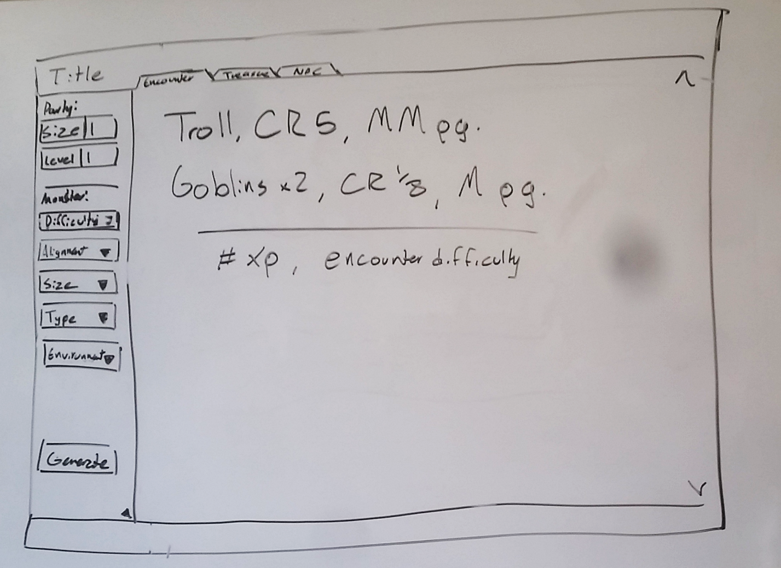
Initial Design
Navigation tabs
Website Title
A sidebar for specifications
Result display with scrollbar
Generate Button

Slide 5
Initial Design
User Feedback
Usability issues
“The drop down lists could be a little shorter”
-Kristjan
Weston chose some specs that no monster has
Solution: an error message
“There should be a function that saves specifications”
-Weston
Just about everyone had trouble using the alignment drop down
Solution: rethink the drop down lists

Slide 6
prototype
What it looks like
User Feedback
“Each drop down list should have an any category”
-Daniel and Gus
“A tab should retain info for when we revisit it”
-Literally everyone
“Can there be multiple monsters with each generation?”
-Weston
“The NPC generator should have more specs, like weapons carried…etc”
-Weston

Slide 7
The real website
What it looks like
Front-end Elements
Back-end Elements
HTML : for division content
JavaScript :for click functionality
for data extraction
CSS: For coloring
for font styles
for picture placement
JSON : for database storage
JavaScript: for data extraction

Slide 8
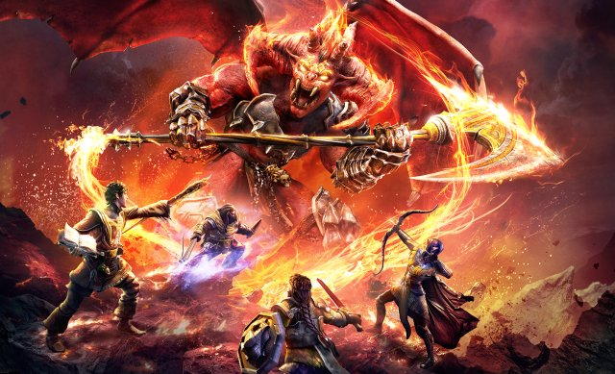
Onward to better gameplay
Thanks for watching

